Slide 1
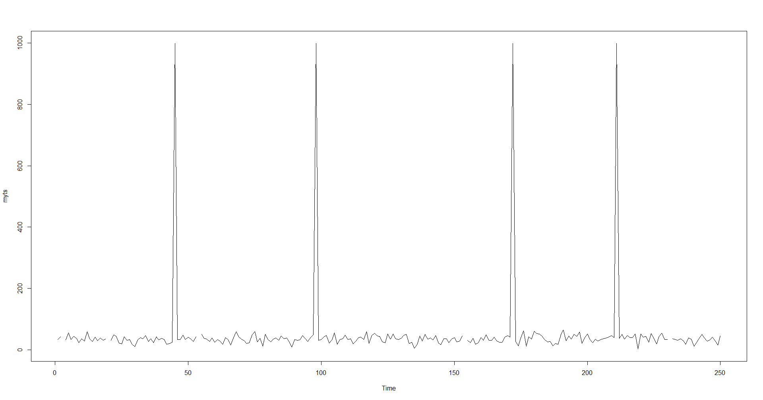

Slide 2
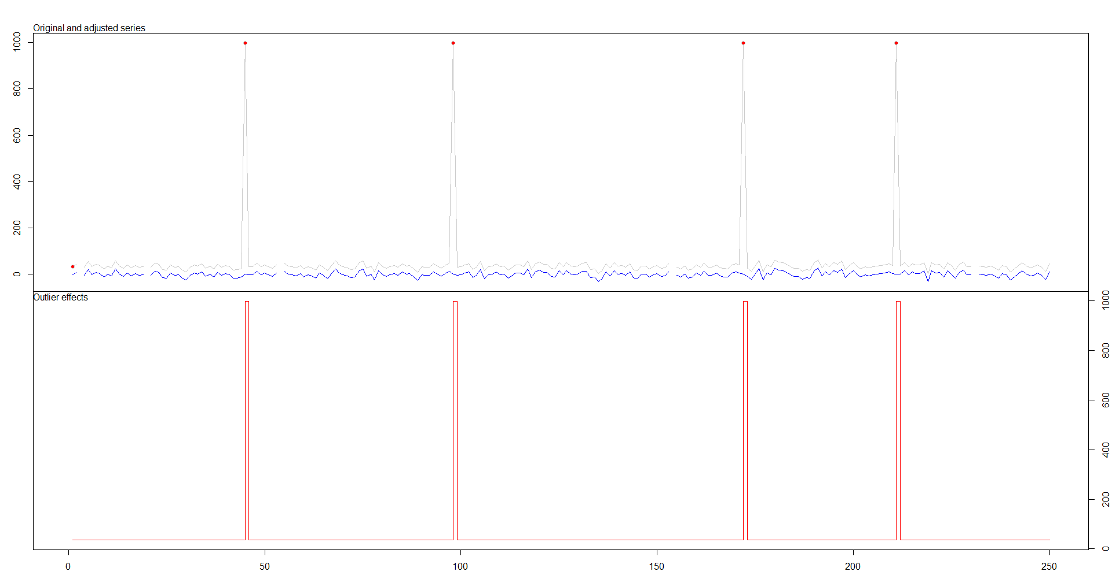
Anomaly detection
Notes:
Outliers:
type ind time coefhat tstat
1 LS 1 1 34.97 48.33
2 AO 45 45 964.03 85.64
3 AO 98 98 964.03 85.64
4 AO 172 172 964.03 85.64
5 AO 211 211 964.03 85.64

Slide 3
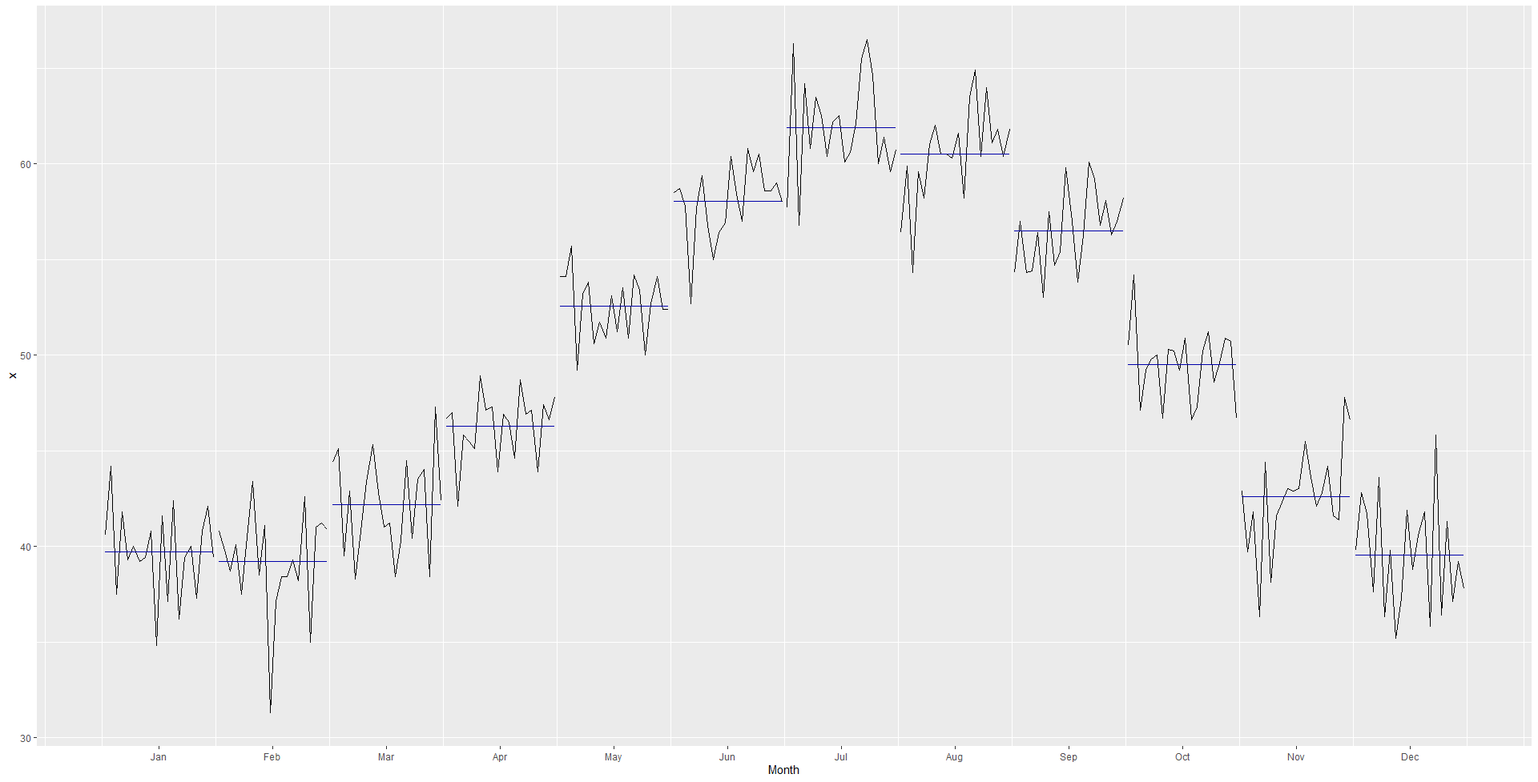

Slide 4
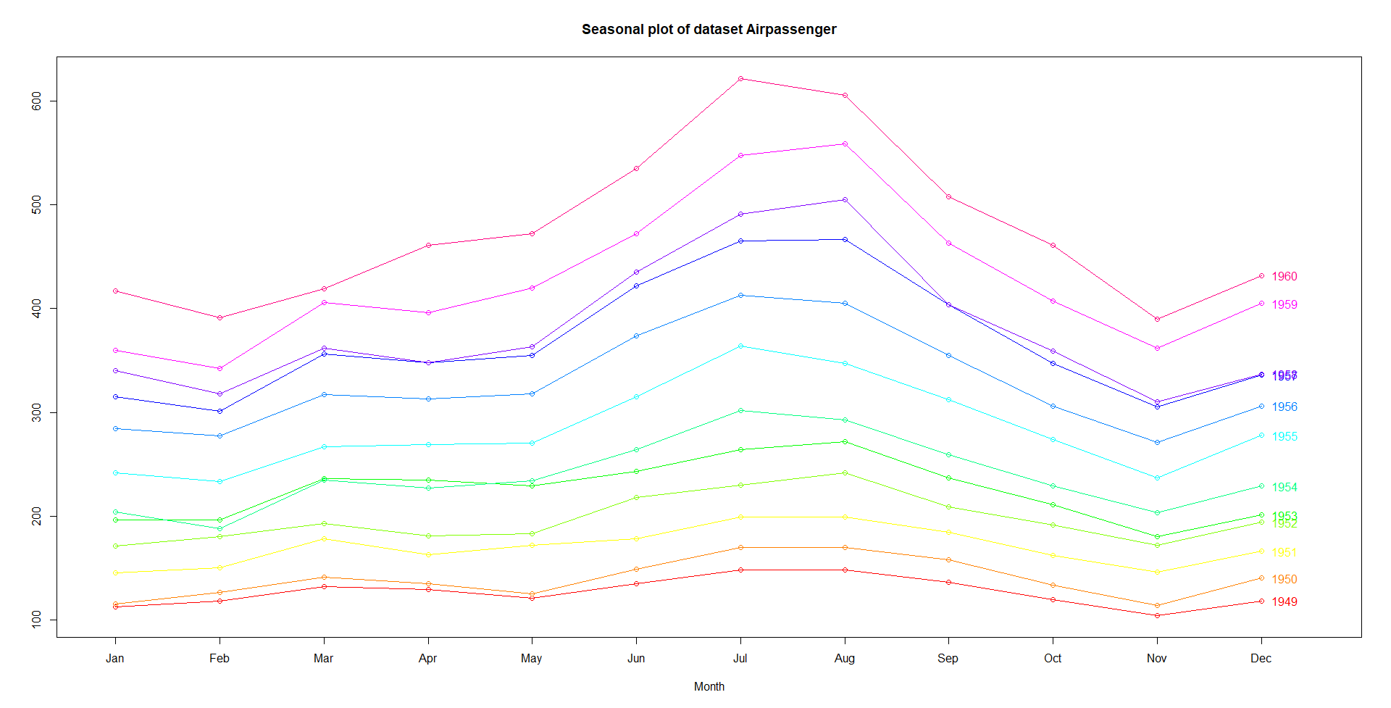

Slide 5
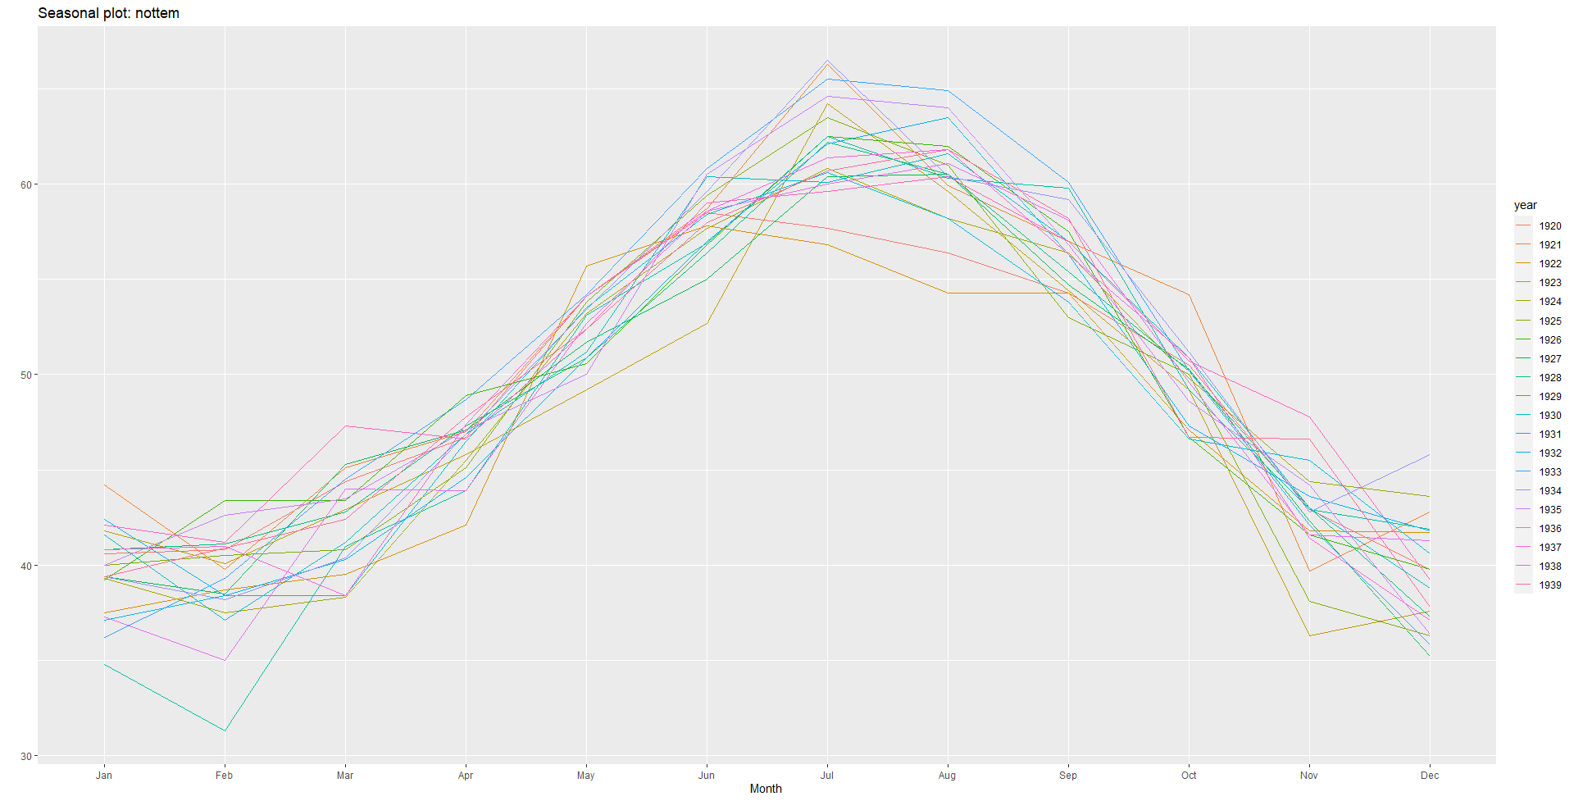

Slide 6
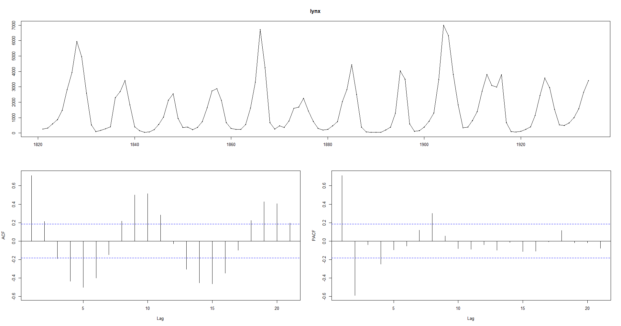
ACF and PACF plot autocorrelation detection

Slide 7
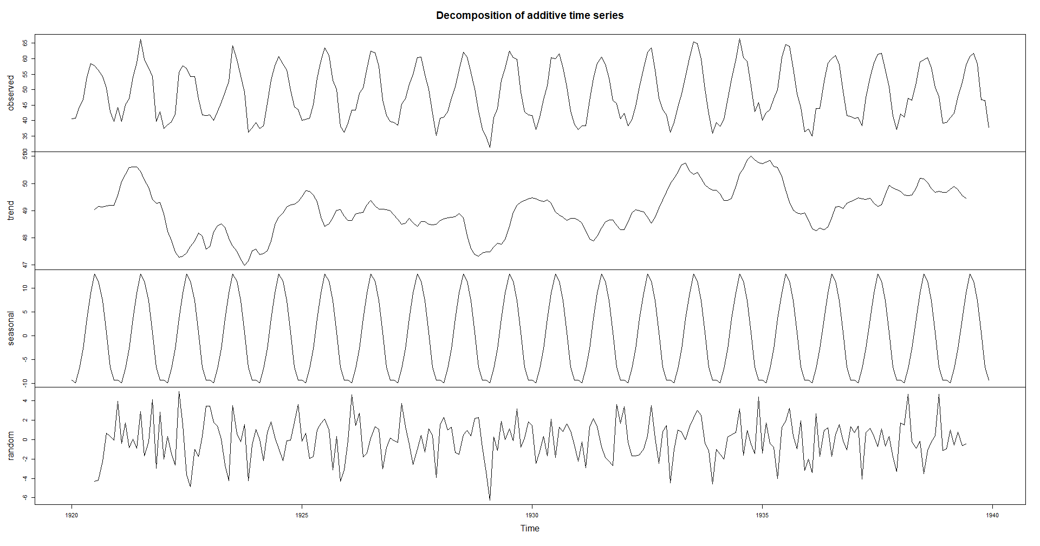

Slide 8
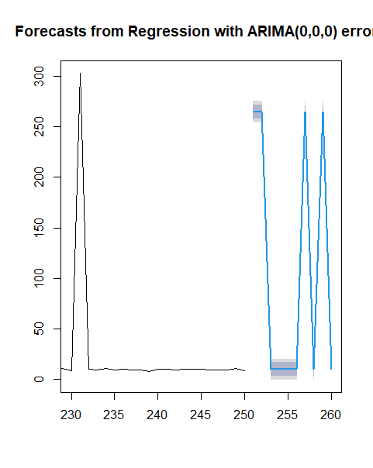
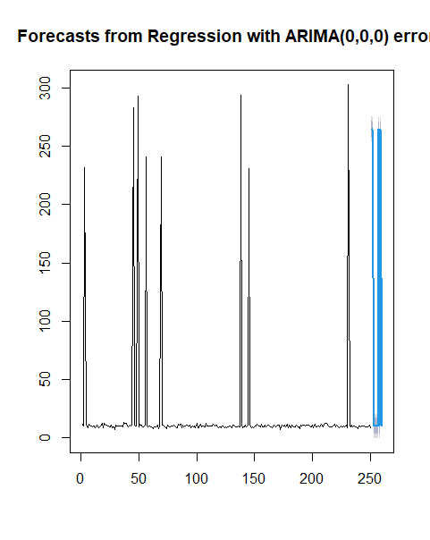

Slide 9
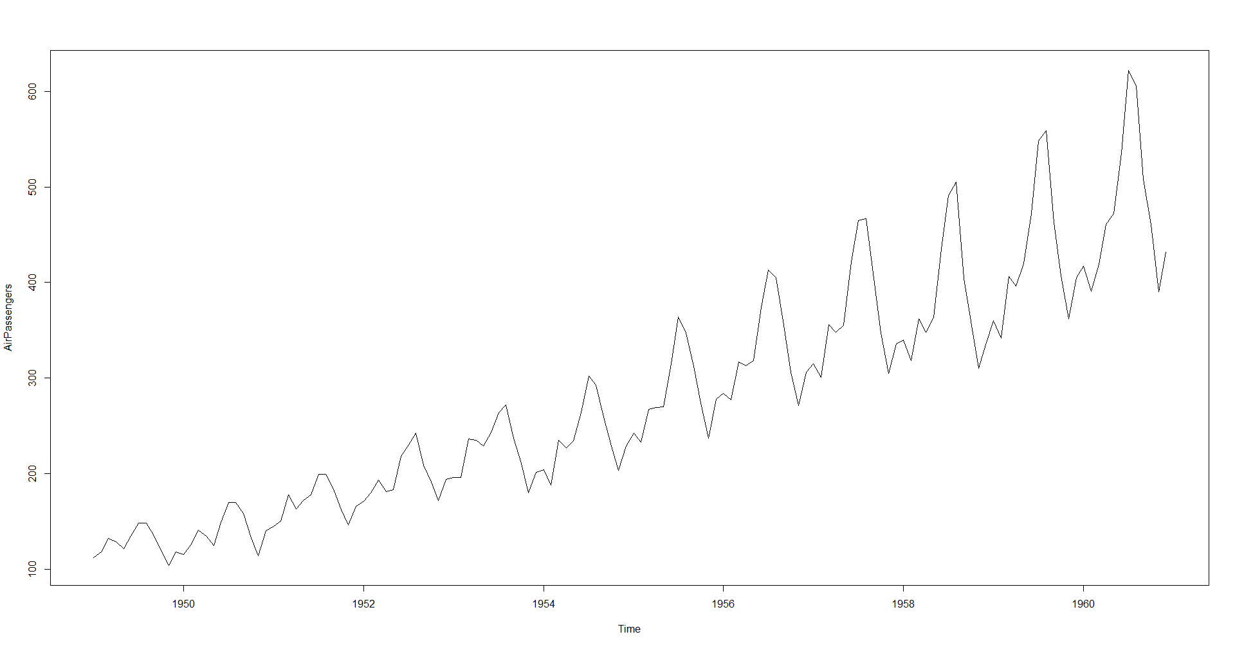

Slide 10
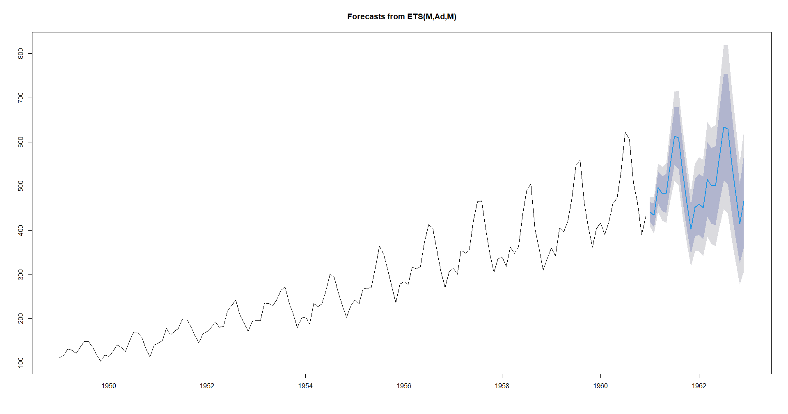

Slide 11
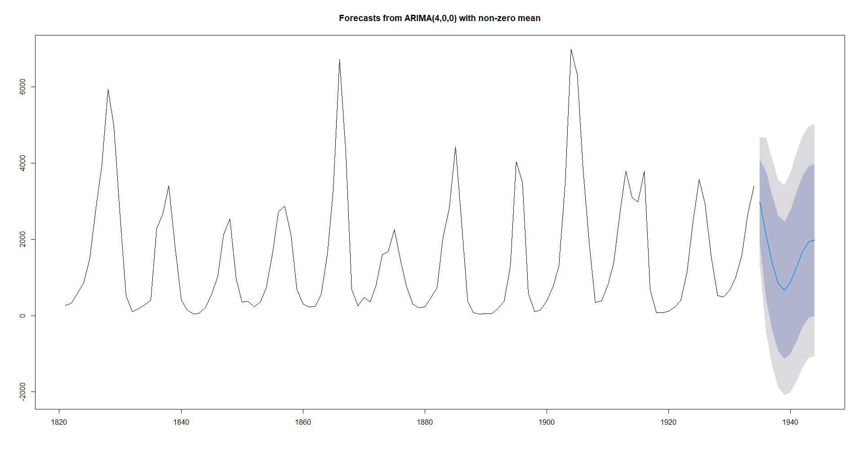

Slide 12
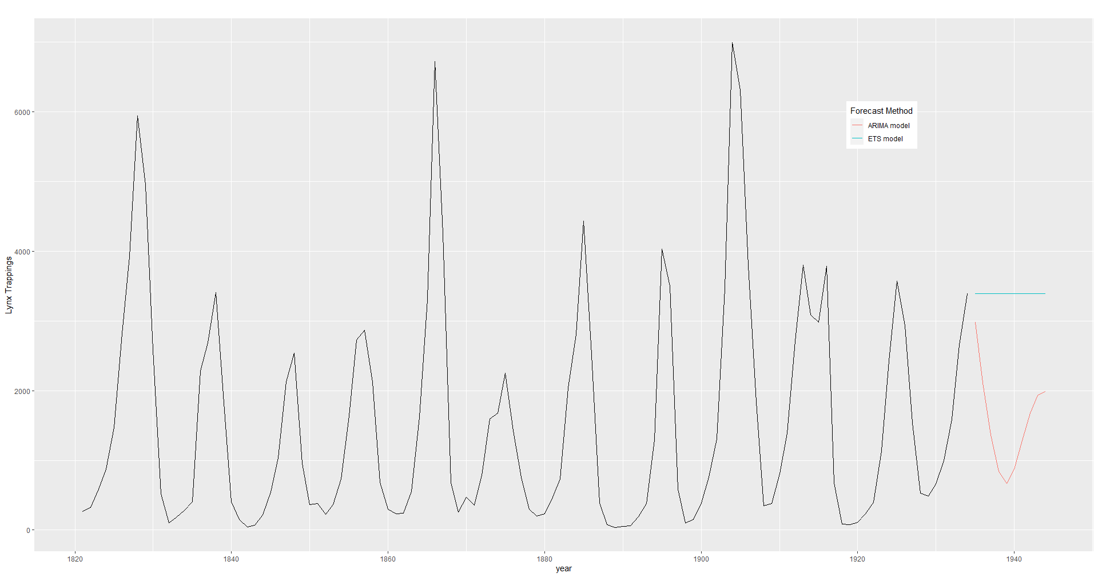

Slide 13
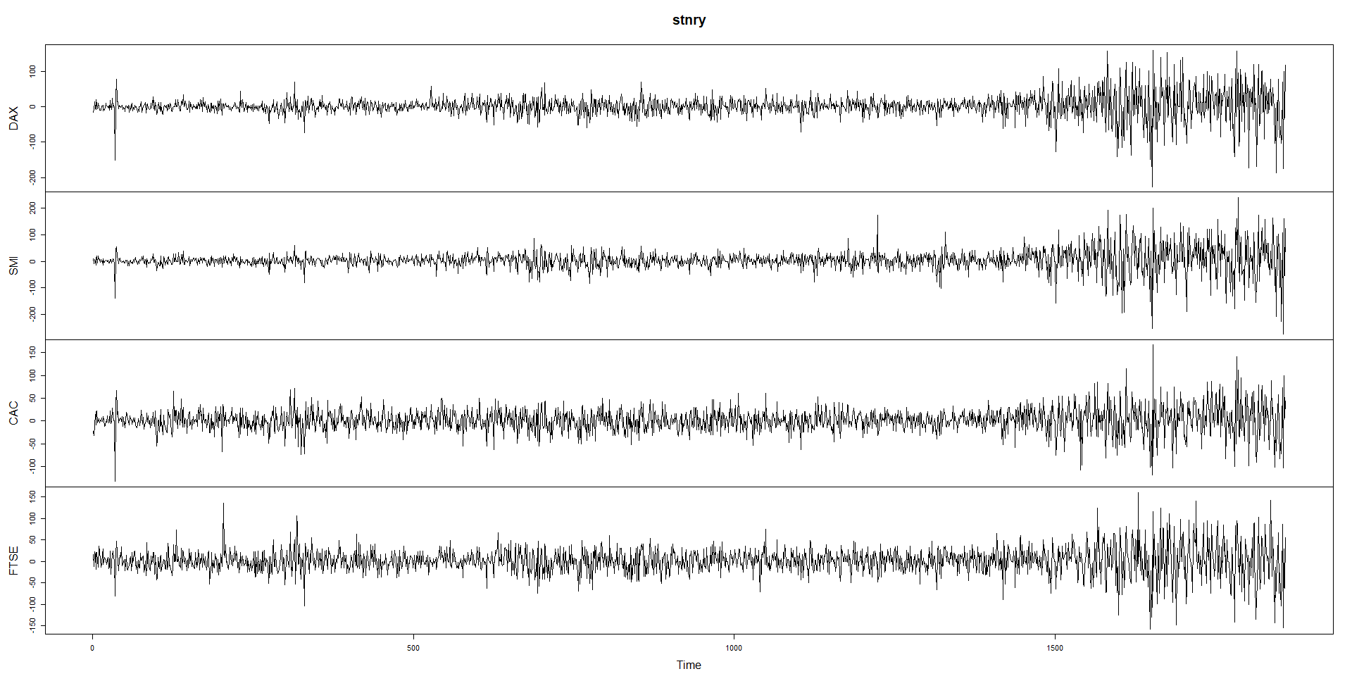
Multivariate time series – Europe's stock market

Slide 14
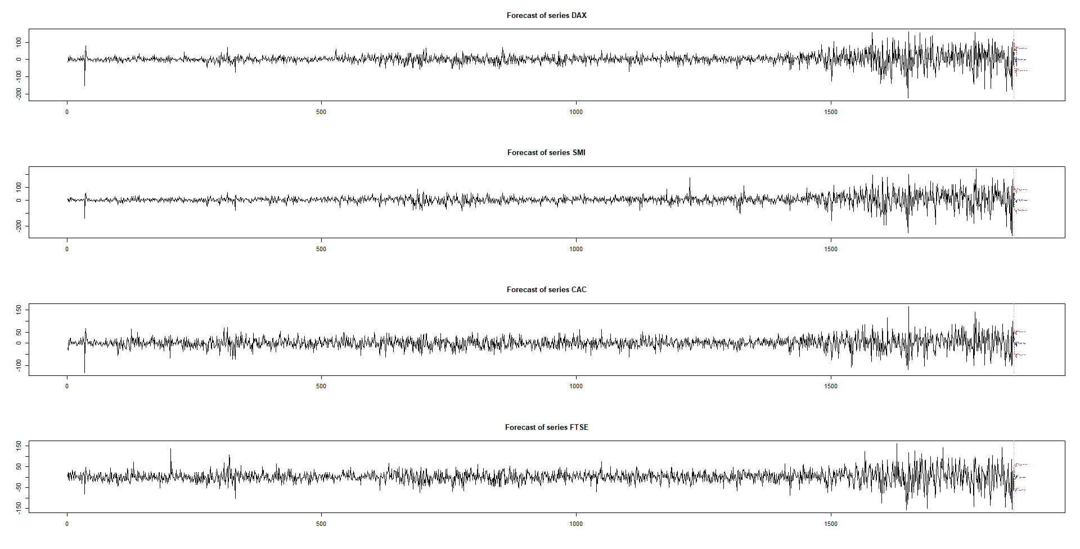
Forecasting multivariate time series – Europe's stock market

Slide 15
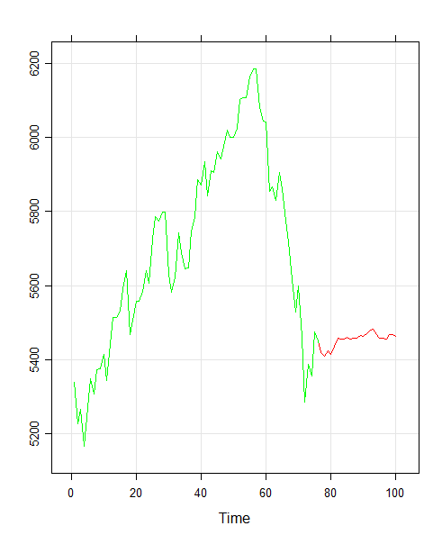

Slide 16
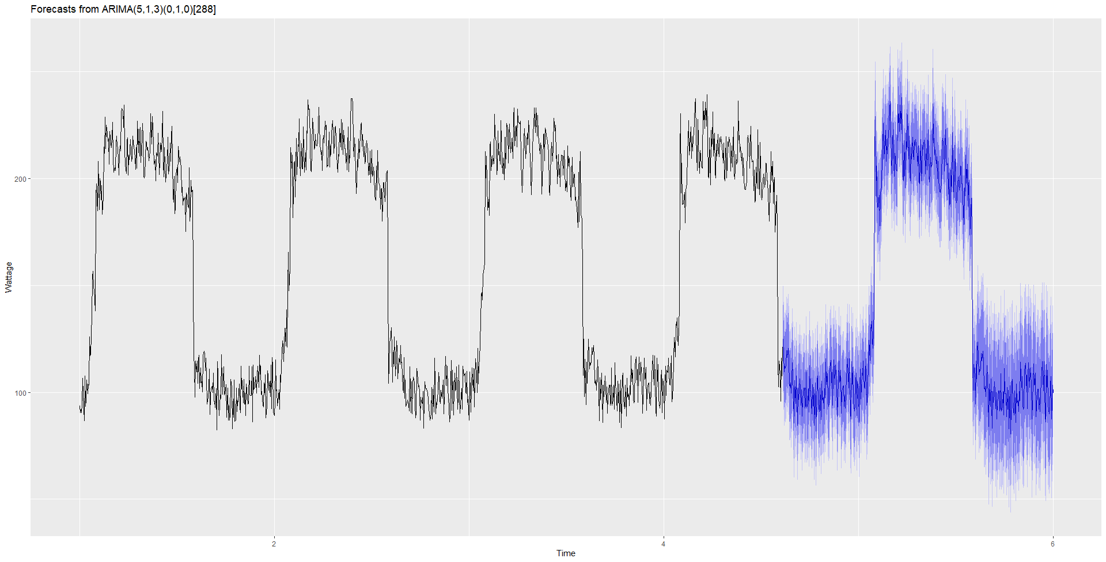
Daily electricity usage – Forecasting with SARIMA

Slide 17
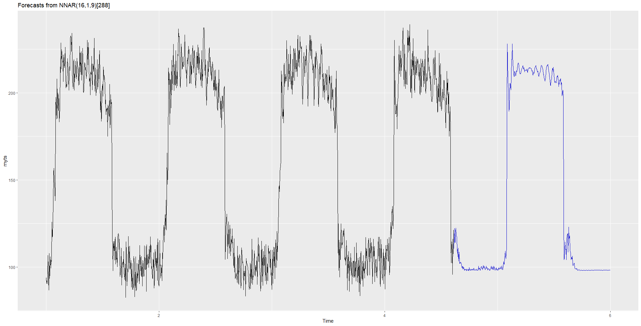
Forecasting with Autoregressive Neural net

